Slide 1

CHAP
Online Coding Education
2017. 12. 18
2016003272 권승주
2016003436 김지원
2016003736 이민수
2016003790 이정음
2016004011 황세현

Slide 2

CONTENTS
Topic
Design
Technology
Usefulness
Demonstration

Slide 3
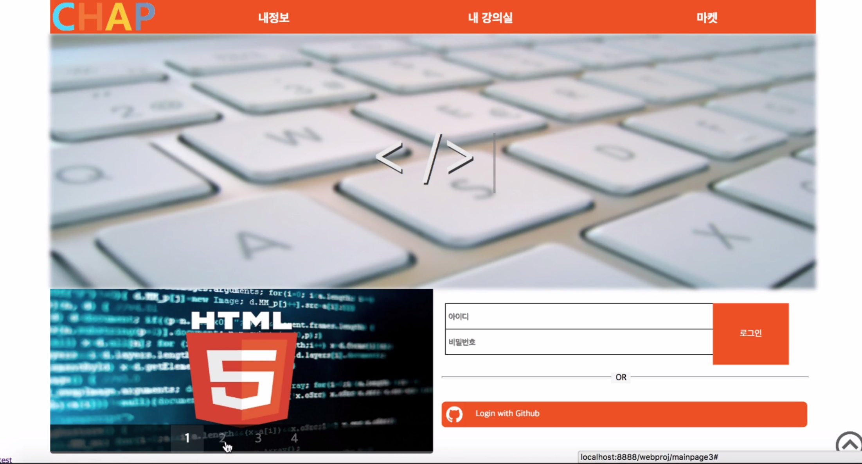
Topic
Web Study Homepage

Slide 4
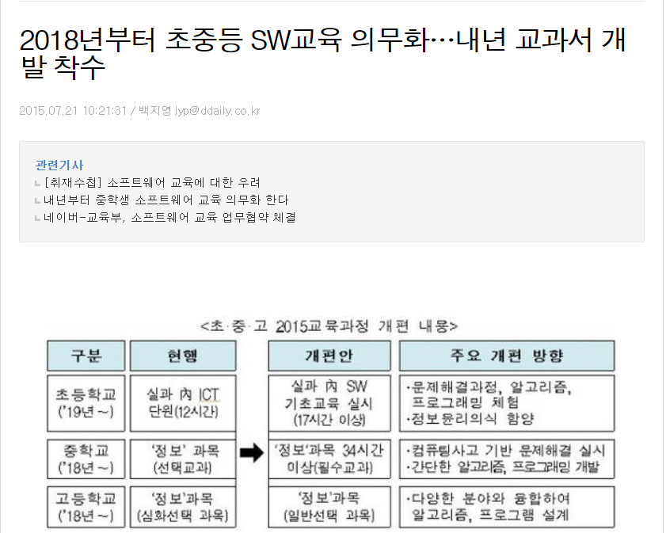
Why?

Slide 5
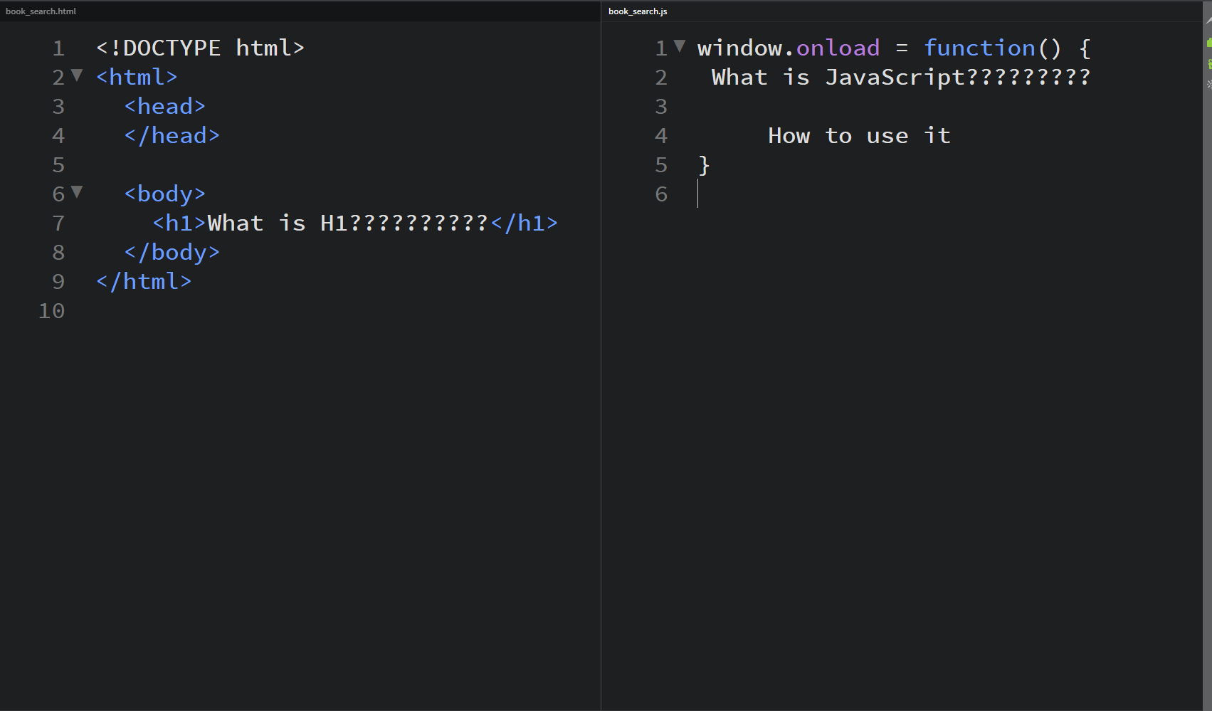
Why?

Slide 6
Design ①

Slide 7
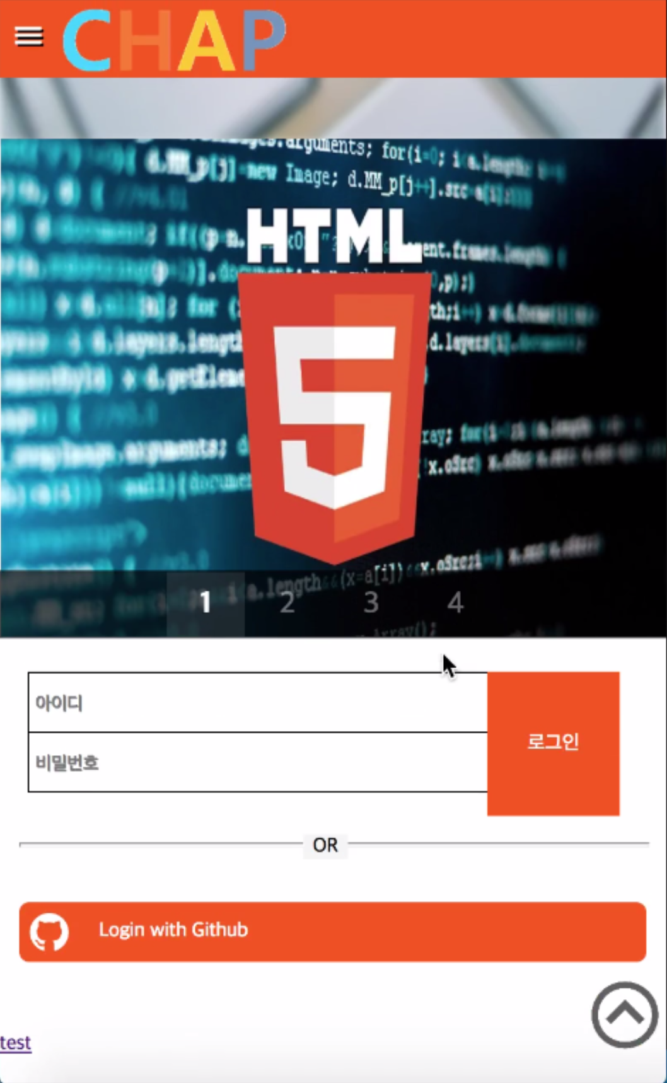
Design ①

Slide 8
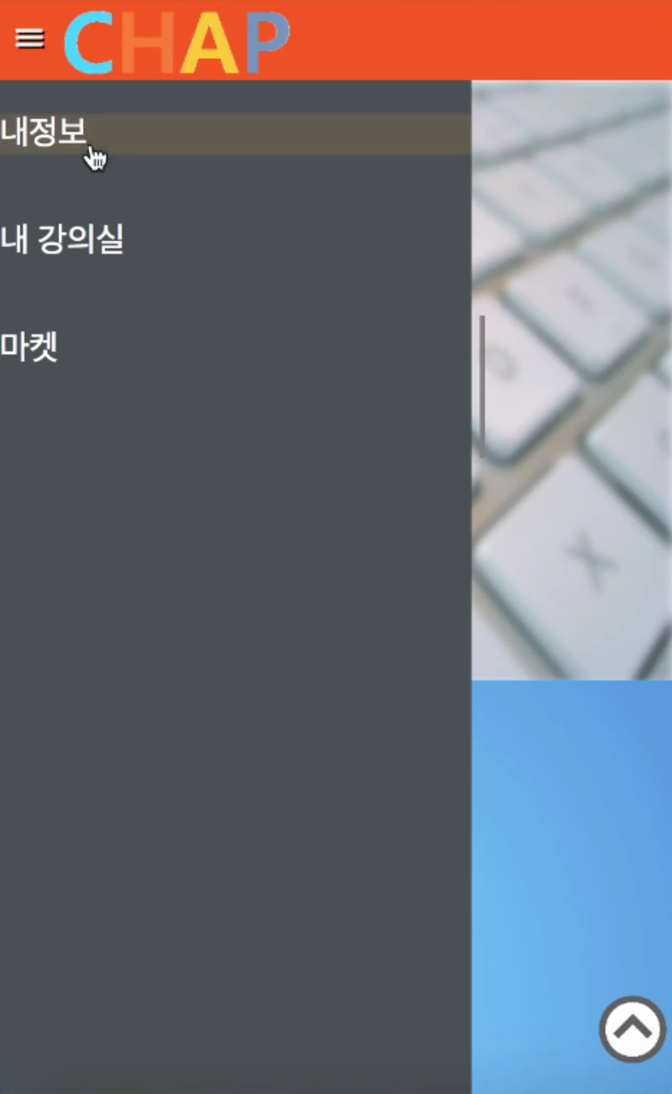
Design ①

Slide 9
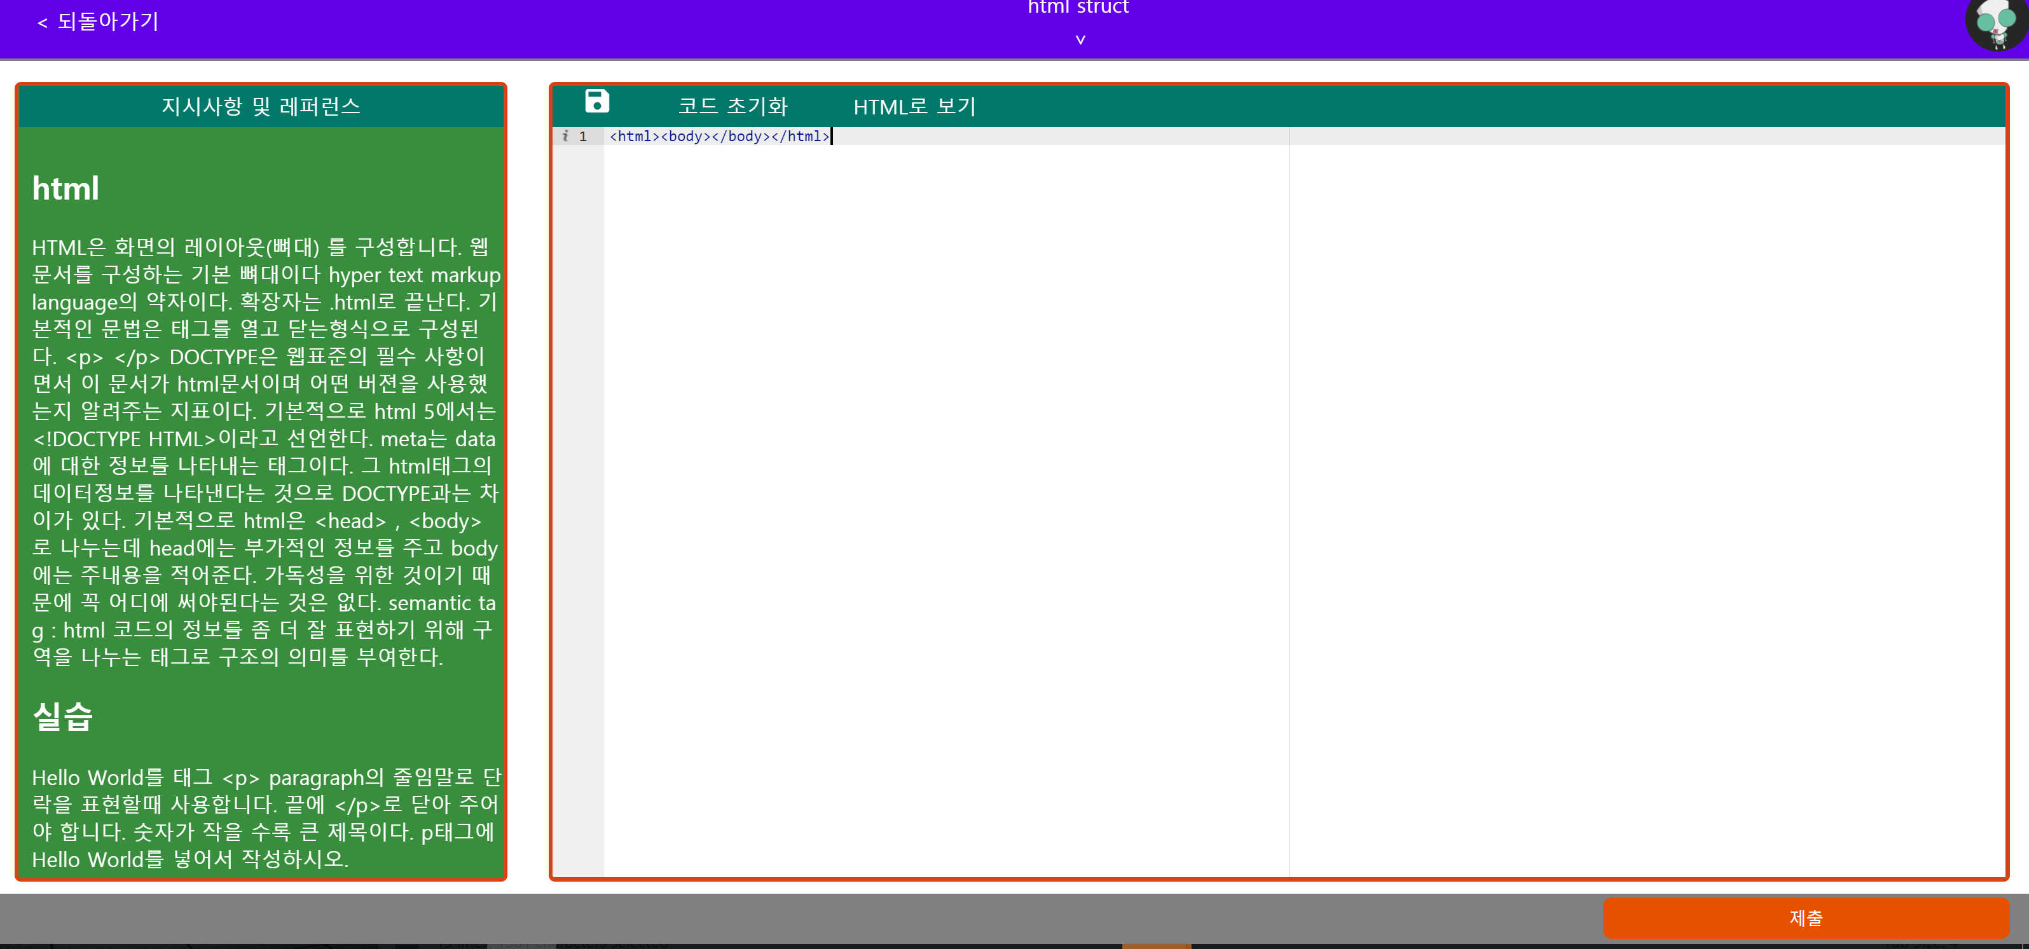
Design ②

Slide 10

Technology ①
Front-End
Html5
Css3
jquery - MIT license
AngularJS - MIT license
responsiveslides.js - MIT license
material-icons - Apache 2.0

Slide 11

Technology ②
Back-End
Php
Mysql
Node.js
Laravel - MIT license

Slide 12
Future Usefulness
Self
Study
Habit
Easy
accessibility
Helpful
Coding
Education

Slide 13
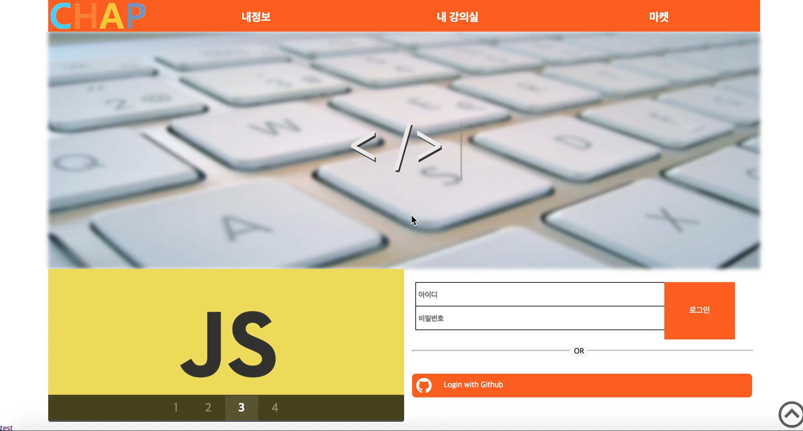

Demonstration

Slide 14
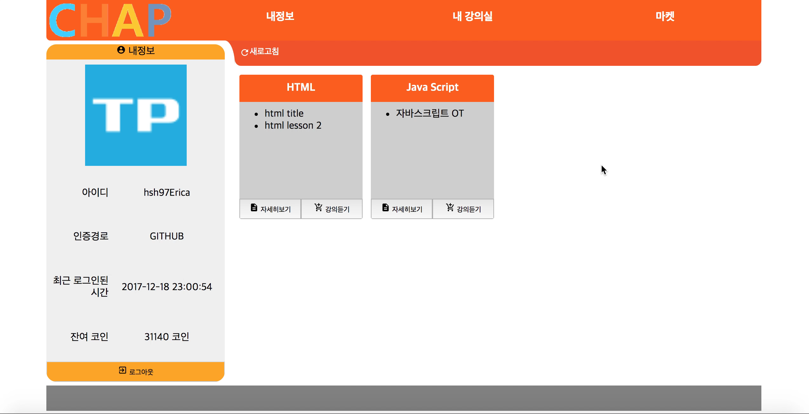
Demonstration

Slide 15
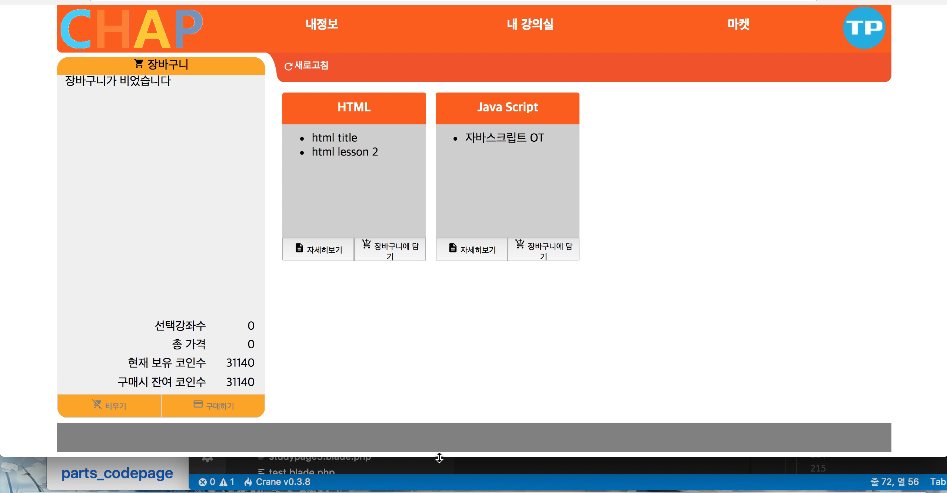
Demonstration

Slide 16
Thanks for Listening

